Slide 1
0-RTT Attack and Defense of QUIC Protocol
Xudong Cao, Shangru Zhao, Yuqing Zhang

Slide 2
Introduction to QUIC and Its Security Challenges
QUIC Overview:
A new transport layer protocol, developed on UDP.
Provides low latency and faster connections.
Used by Google and other applications (e.g., YouTube, Weibo).
Integrated into HTTP/3 by IETF.
Security Concerns:
Vulnerabilities identified, such as replay attacks and packet manipulation.
UDP's connectionless nature exposes QUIC to security issues during handshake and connection setup.

Slide 3
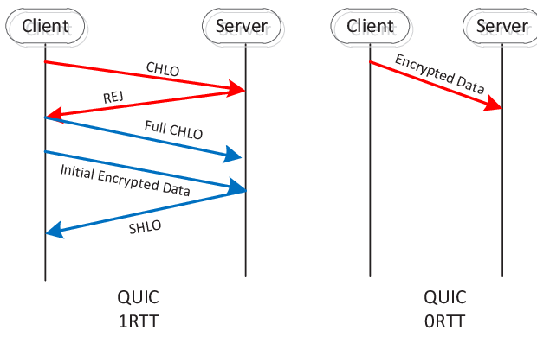
QUIC Protocol Analysis
Packet Structure:
UDP packets: simple, with a size limit of 64KB.
QUIC has ordinary (encrypted) and special (sometimes unencrypted) packets.
Special packets like version negotiation are unencrypted, vulnerable to spoofing.
Connection Establishment & Release:
QUIC has an initial and non-initial handshake.
Connections can be terminated with specific frames ("GOAWAY" or "CONNECTION_CLOSE"), or PUBLIC_RESET (vulnerable to spoofing).

Slide 4
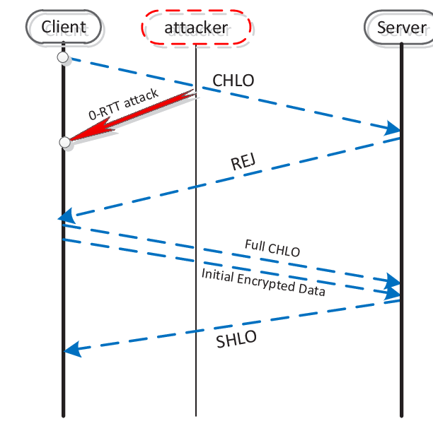
0-RTT Attack: New Security Threat
0-RTT Attack Overview:
The 0-RTT attack occurs when the client and server have not yet completed a data interaction.
The client refuses service by receiving a forged packet before a full connection is established.
Exploits unencrypted packets in QUIC during the connection phase.
Attack Types:
QUIC RST Attack: The attacker sends a reset packet (after the interception of the CHLO frame), misleading the client into thinking the server rejected the connection.
Version Forgery Attack: The attacker sends a fake version negotiation packet, causing the client to abandon the connection.

Slide 5
Sending the Encapsulated Packet to the Client: The attacker intercepts the request sent by the client (using the Scapy library) and obtains the necessary information like Connection ID, source port, and destination port. The attacker then forges a packet and sends it to the client, causing the client to believe that the server wants to reject the connection. After receiving a Public Reset Packet, the client actively ignores any further QUIC packets related to that connection. This attack does not affect the server.
Version Forgery Attack Experiment: In this attack, the attacker forges the Version_Negotiation packet, modifying the Public Flag, Connection ID, and the QUIC version supported by the server. The client receives this falsified packet, sees unsupported versions, and requests the server to drop the connection. This results in a failed request and an error (QUIC_INVALID_VERSION), but the server remains unaffected.
Preconditions for Attack:
Attacker must intercept the client’s request packet via methods like Port Mirroring, Hub Usage, or ARP Spoofing.
Attack Execution:
Encapsulated Packet Sent to Client: Spoofed packets are sent to the client, causing it to ignore valid connections.
Version Forgery Attack: Modified packets are sent to make the client drop the connection.
Analysis: QUIC does not protect the client during connection setup.

Slide 6
Solutions and Challenges
Proposed Solutions:
Short Wait Time: Clients should wait (200ms) before interrupting the connection to verify authenticity.
Multiple Interactions: Clients should interact with the server multiple times to prevent packet forgery.
Challenges:
Adding wait times or interactions delays the connection setup, contradicting QUIC's goal of fast connections.
Balancing security with speed remains a challenge.

